Slide 1
Browser Forensics
The Data Source and some questions are adapted from NCL 2017

Slide 2
Introduction

Slide 3
What is web browser
A web browser (commonly referred to as a browser) is a software application for accessing information on the World Wide Web (wiki).

Slide 4
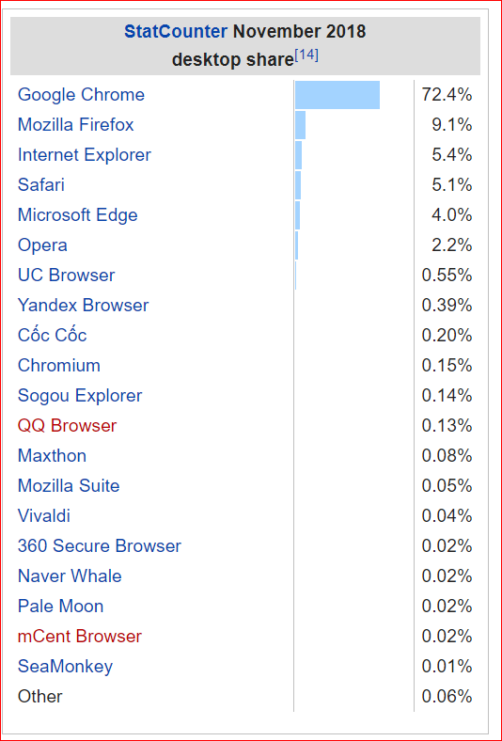
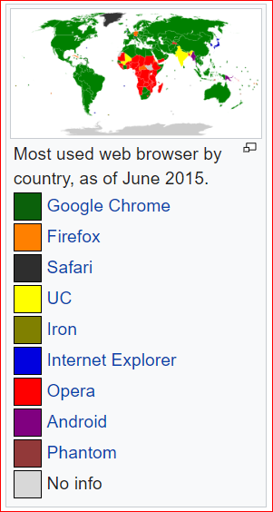
Market share

Slide 5
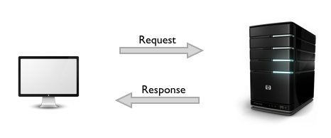
URL
Each individual web page, image, and video is identified by a distinct Uniform Resource Locator (URL) , enabling browsers to retrieve and display them on the user's device.

Slide 6
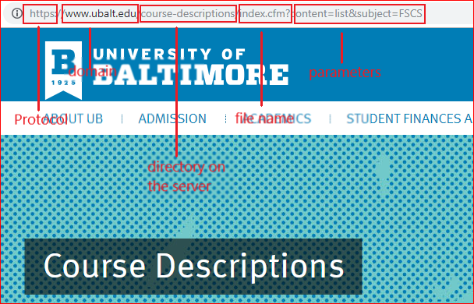

Slide 7
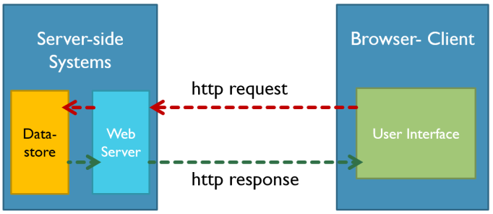

Slide 8
What evidence will browser save?

Slide 9
Internet Explorer
Temporary Files
C:\Users\<user>\AppData\Local\Microsoft\Windows\Temporary Internet Files
The cookies

Slide 10
Firefox
default location
C:\Users\<user>\AppData\Roaming\Mozilla\Firefox\Profiles\<profile folder>
Cache
about:cache in the address bar
cookies.sqlite
downloads.sqlite
places.sqlite
a record of visited pages
bookmarks, favorite icons, input history, keywords, and browsing history

Slide 11
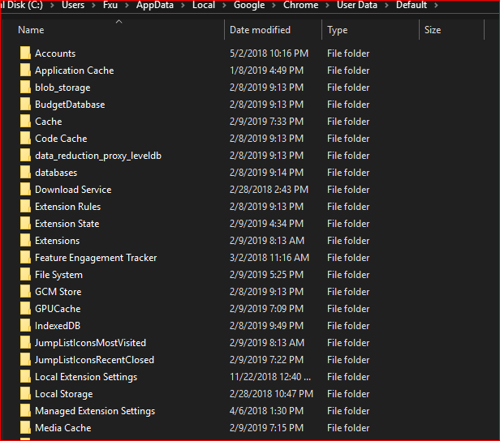
Google Chrome
Location
C:\Users\<user>\AppData\Local\Google\Chrome\User Data\
Contains
Browser cache
Cookies
Plugin data
History
More details
https://chromium.googlesource.com/chromium/src/+/HEAD/docs/user_data_dir.md#Windows

Slide 12
Log Analysis

Slide 13
storage media vs RAM
RAM stores information
running process, incognito browsing sessions, clipboard data , information stored in plain text files and much more.
Essential for malware analysis
running process information, services, system service behavior, registry updates, network traffic
Other artifacts
browsing sessions (Incognito Sessions) , passwords, accessed files and multimedia, Chats/Running Application stored data

Slide 14
Pre- Acquisition Process
Host machine should not be connected to any external network
Disconnect LAN/WIFI/Bluetooth connections by putting the device in airplane mode
Ensure the device is unlocked without installing any password bypassing module
Remove any external connected devices
Host machine should be connected to a stable power source

Slide 15
steps for acquisition
Determine the state of the machine
Identify the operating system
Check for authentic device access
Insert acquisition media
Perform Volatile Memory Dump
Collect SWAP, PAGEFILE.sys and system protected files
Hash and verify the acquired files
Create Investigator copies

Slide 16
Firefox Log acquisition

Slide 17
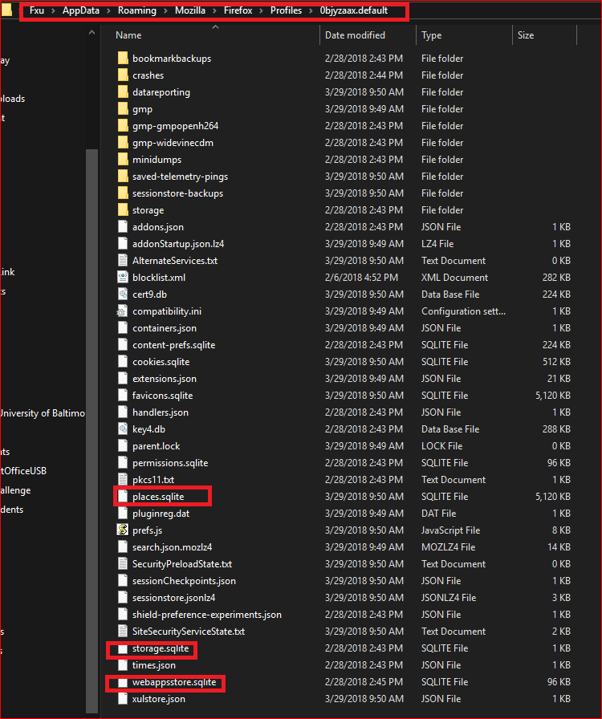

Slide 18
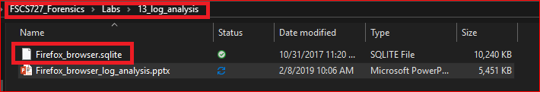
Logs used in this lab
Data Source: NCL 2017

Slide 19
Goal of the lab
A suspect used bitcoin for money laundry
Your task is to find evidence in the suspect’s browser (Firefox).

Slide 20
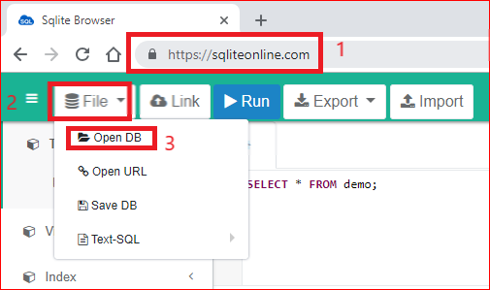
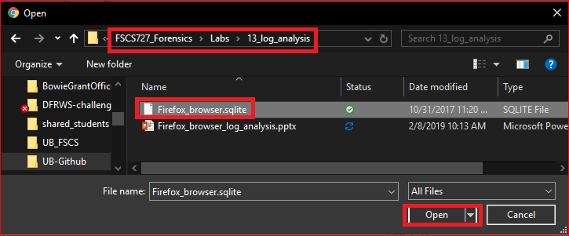
Open Firefox logs

Slide 21
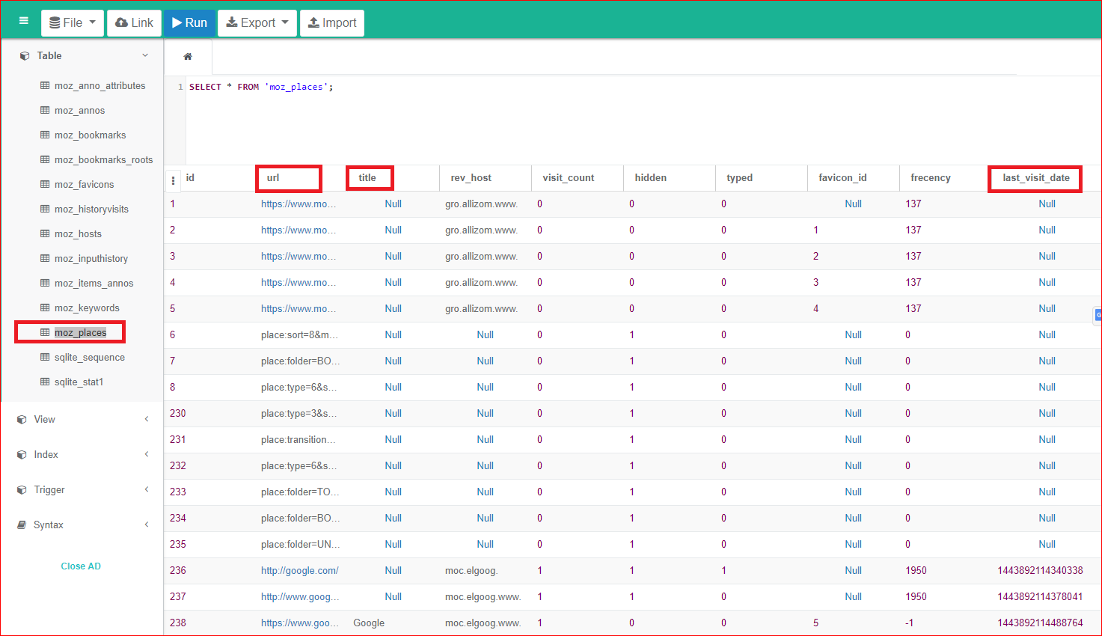

Slide 22
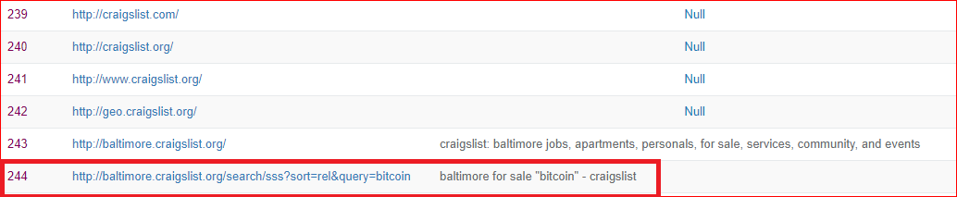
What item did the user search for on craigslist?
It seems the user lived in Baltimore. Why?

Slide 23
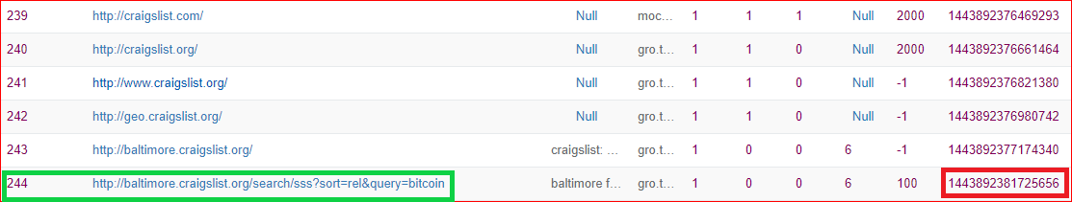
When did the user search the item?
UNIX Epoch time:
It is the number of seconds that have elapsed since 00:00:00 Thursday, 1 January 1970
How to convert Epoch time to Date/Time?

Slide 24
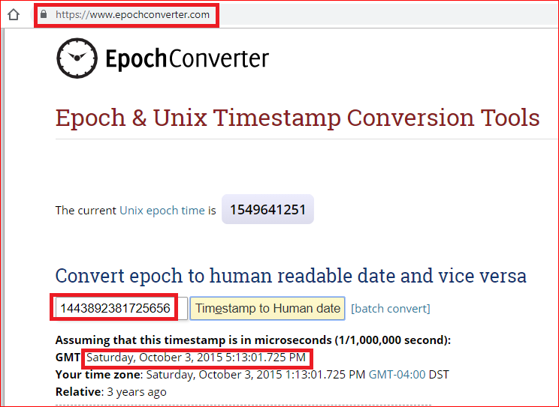

Slide 25
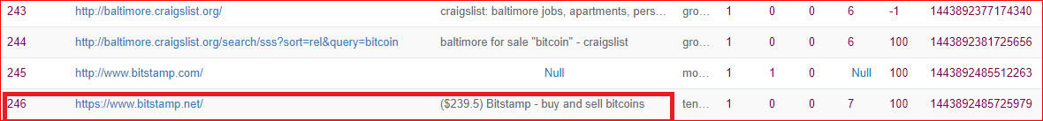
What was the current price of bitcoin when the user was browsing?

Slide 26
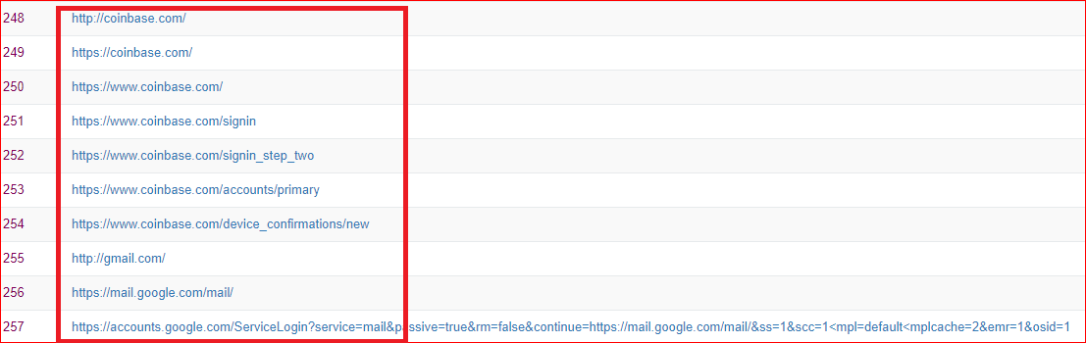
What Bitcoin exchange did the user log in to?

Slide 27
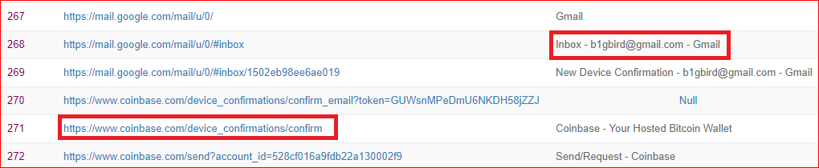
What is the email that was used to log into the exchange?

Slide 28
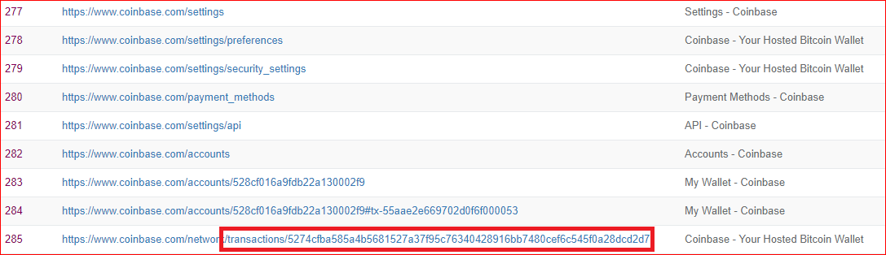
What was the ID of the Bitcoin transaction that the user looked at?

Slide 29
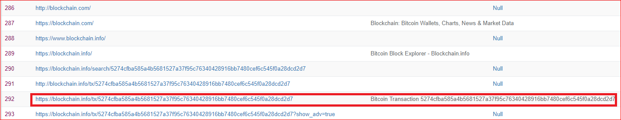
What was the total value of all the inputs of the Bitcoin transaction?

Slide 30
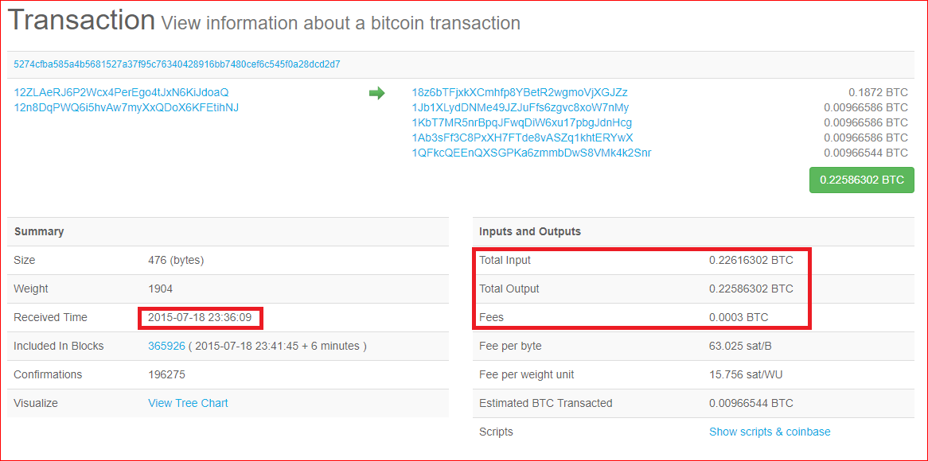

Slide 31
Your work
Write a report
When
Where
What
Who
Which tool has you used?

Slide 32
Reference
http://sci.tamucc.edu/~cams/projects/345.pdf

